Slide 1


Uni:4U

Slide 2
Uni:4U
What?
When?
Why?
Notes:
What-
programme of activities that take place over the course of a few days at a range of universities and higher education institutions across Greater Manchester.
taking part in activities and workshops looking at your future or certain subjects,
working with current uni students
residential events staying in university halls.
Free- food
When-
During June and July
2-4 days, some overnight stays
Why-
gain a real-life insight into what university is like,
help you make a decision about life after school / college
find out more about certain subjects,
Meet new people
Something to put on your UCAS form

Slide 3


Uni:4U
I attended Uni:4U and...
Notes:
Showing the video is crucial
https://www.youtube.com/watch?v=ldE_YnNS8Mg

Slide 4
Uni:4U
After attending:
95% of attendees agreed or strongly agreed with ‘I am now more likely to think about going to university/higher education’
“It was brilliant. Everybody is so lovely and the information I have received has really broadened my mind into what I will be studying at University”
Melissa, Aquinas College
I attended Uni:4U and...
“I got to learn more about university life by talking to current undergraduate students”
Momin, Audenshaw School Academy Trust
Notes:
Alternative to showing the video

Slide 5
Uni:4U
MSC Summer Schools are a Medical Schools
Council initiative in partnership with medical
schools across England.
Are you a Year 12 student interested in
Medicine? This summer school will help you to
explore whether medicine is the right choice for you! You will receive the information, skills and, above all, the confidence needed to submit a strong application to medicine, as well as taking part in a series of fun and rewarding workshops, lectures, interactive and social activities.
Please note there is additional targeting criteria for this event.
Journey to Medicine
Location
University of Manchester
Dates
8- 11 July 2019
Number of places available
70
Residential/Non-residential
Residential
gmhigher.ac.uk
Notes:
Use the remaining time to talk through-
Short summary- 8 events, 3 residential, 5 non-residential – range of subject areas, and general
If time can pick out highlights from each programme.

Slide 6
Uni:4U
Capital Summer School
Location
AccessHE, London
Dates
23 - 25 July 2019
Number of places available
50
Residential/Non-residential
Residential
Have you ever wondered what it would be
like to study in the UK’s capital city?
During the AccessHE Capital Summer School, you will have the opportunity to experience higher education in both central and outer London by visiting two London universities.
You will also choose a subject strand to pursue for the duration such as: Humanities, Arts and STEM, but it’s not all academic, you will also ride in the London Eye and catch a West End show.
gmhigher.ac.uk

Slide 7
Uni:4U
Media Summer School
Location
University of Salford
Dates
24 - 26 July 2019
Number of places available
24
Residential/Non-residential
Residential
The Media Summer School at University of
Salford will give you the chance to experience
a number of different taster sessions at our
state of the art Media City UK campus. You will
learn Digital and Broadcast Media theories from our academics and apply them in our industry standard facilities, supported by technicians.
You will visit the BBC and discover the media
career opportunities in Salford, and develop a
final project to demonstrate your learning.
gmhigher.ac.uk

Slide 8


Slide 9
Uni:4U
FastTrackers
2019
Location
University of Manchester
Dates
18 - 20 June 2019
Number of places available
150
Residential/Non-residential
Non-Residential
Fast Trackers is an exciting, nationwide
programme promoting careers in the
engineering industry and is delivered in
partnership with Network Rail and Mott
MacDonald.
What’s in it for you?
You will get the chance to meet industry experts and VIPs with a wealth of knowledge and advice. Alongside, learning about routes into higher education and visiting a local engineering employer.
gmhigher.ac.uk

Slide 10
Uni:4U
HE on
Tour
Location
Manchester Metropolitan University, University of Bolton & Wigan & Leigh College University Centre
Dates
1 – 3 July 2019
Number of places available
20
Residential/Non-residential
Non-Residential
Thinking about Higher Education but not sure
about which route to take?
Take part in this summer school and get to
explore the different pathways into a degree.
You will get the opportunity to experience
what it is like to study for a degree in a
college environment compared to studying
in a university, and if you are thinking about
applying for a Higher/Degree Apprenticeship,
you will learn what it takes to be an ideal
candidate.
gmhigher.ac.uk

Slide 11
Uni:4U
Exploring Chemistry
Location
Manchester Metropolitan University
Dates
2 - 3 July 2019
Number of places available
40
Residential/Non-residential
Non-Residential
Come and find out what it’s like to do
science in our state-of-the-art laboratories
getting experience of making amazing
chemiluminescent molecules that glow in the
dark and could illuminate cities in the future.
Use high-tech equipment to analyse unknown
molecules, deduce their structure, and find
out about the career opportunities available
to you if you study a Chemistry related subject
at university.
gmhigher.ac.uk

Slide 12
Uni:4U
Explore Molecular Microbiology
Location
Manchester Metropolitan University
Dates
2 – 4 July 2019
Number of places available
20
Residential/Non-residential
Non-Residential
This three-day workshop aims to give you
an insight into life as a molecular scientist or
microbiologist and the chance to try out a
variety of practical laboratory skills including
microbiology culturing, DNA extraction
techniques, Polymerase Chain Reaction
(PCR), and microscopy.
We will provide you with vital skills for future study or a career in molecular biology or microbiology; introducing you to the theory and giving you ‘hands-on’ experience.
gmhigher.ac.uk

Slide 13
Uni:4U
Can we construct it? Location
University Campus Oldham
Dates
23 - 25 July 2019
Number of places available
30
Residential/Non-residential
Non-Residential
Open your eyes to the world of construction,
one of the largest and most exciting
industrial sectors in the world that employs
a huge number of professionals from various
backgrounds.
You will explore what the world of construction has to offer whilst developing
a rounded, teamwork approach, problem
solving skills and communication skills. You
will build knowledge of the construction
industry; visit a real working construction
site and more!
gmhigher.ac.uk

Slide 14
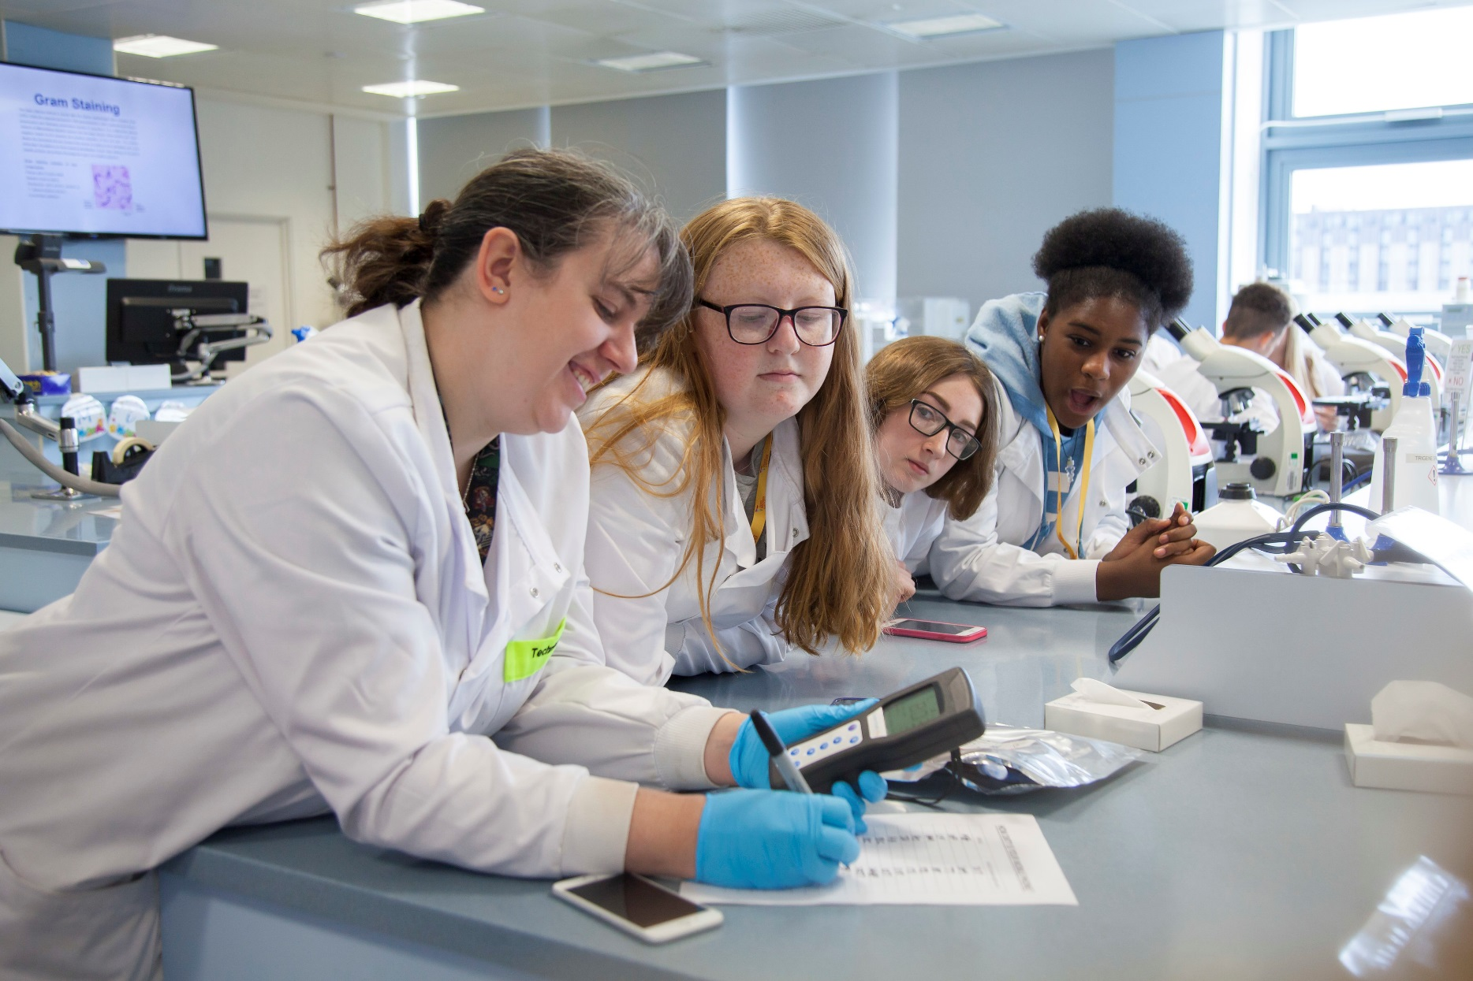

Slide 15
Uni:4U
How to
sign-up?
If you are interested in attending please collect a brochure at the end of this assembly to find out more about the events.
You can sign up directly through our website:
gmhigher.ac.uk/events-and-activities/
Notes:
If need help /advice doing app form can contact event leads, there details are online
Stress that places are limited and that learners who meet our targeting criteria will be prioritised (see website)- this is in the brochure.
Stress that we need parent consent- this is also on the website when you apply

Slide 16
@gm_higher @GM_Higher
@GreaterMcrHigher @GM_Higher
gmhigher.ac.uk
gmhigher.ac.uk
Notes:
Find out more on website / social media

